Slide 1

Project Proposal
Team X- Tumbler
13.06.2020

Slide 2

Line Following
Color detection
01
03
Wall Following
Ramp
02
04
Line following strategy including sensors, hardware design, Algorithm and etc.
Robot arm working principle including color detection strategy with sensors, actuators and etc.
Wall following strategy including sensors, hardware design, Algorithm and etc.
Strategy for passing Ramp successfully and robot control
Gates
05
Strategy for identifying the gate sequence and passing two gate
Team X- Tumbler
13.06.2020

Slide 3
02
Wall Following Pole Detection & Box Detection
Strategy including sensors, hardware design & Algorithm
Team X- Tumbler
13.06.2020

Slide 4
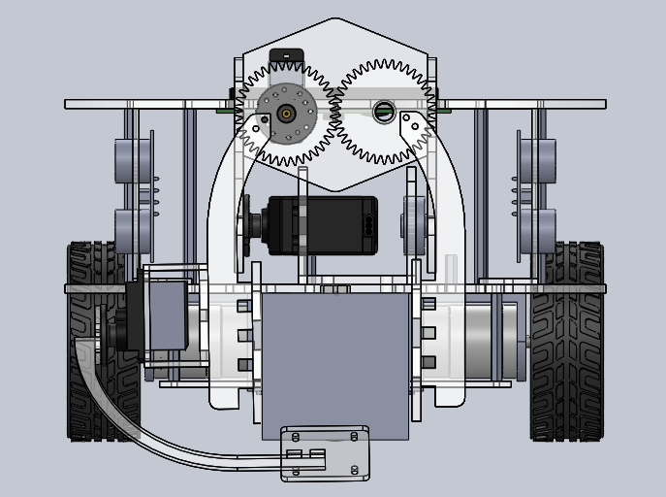
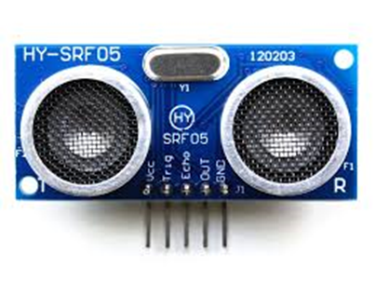
Wall Following & Pole Detection
[] Two Ultra Sonic (SRF 05) sensors are used.
[] Uses time of flight principle
[] Has a good accuracy → enough for our purpose
[] Cheap
[] Easy to control
[] Good range of measuring → Has a range of 3cm to 4m & operate frequency range
of 40-60 kHz.
1
2
Team X- Tumbler
13.06.2020

Slide 5
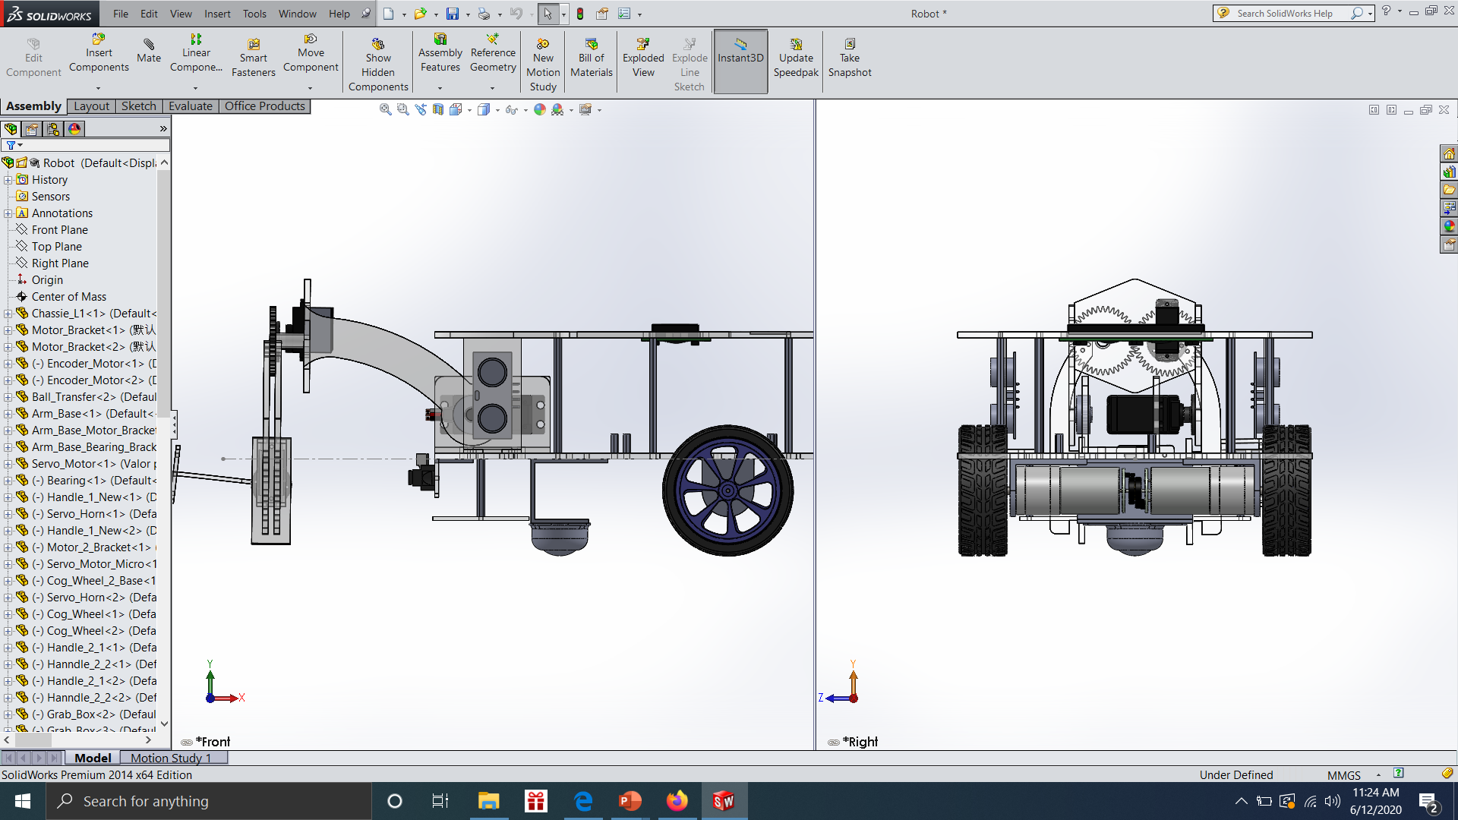

[] Calculate the distance between the wall and sensor. As well used to count the number of poles.
[] As there are two curved walls, we planned to detect each wall by left/right or using both sensors.
[] Signals that given by the sensors are send to the Arduino board and then speeds of motors will be
controlled.

Slide 6
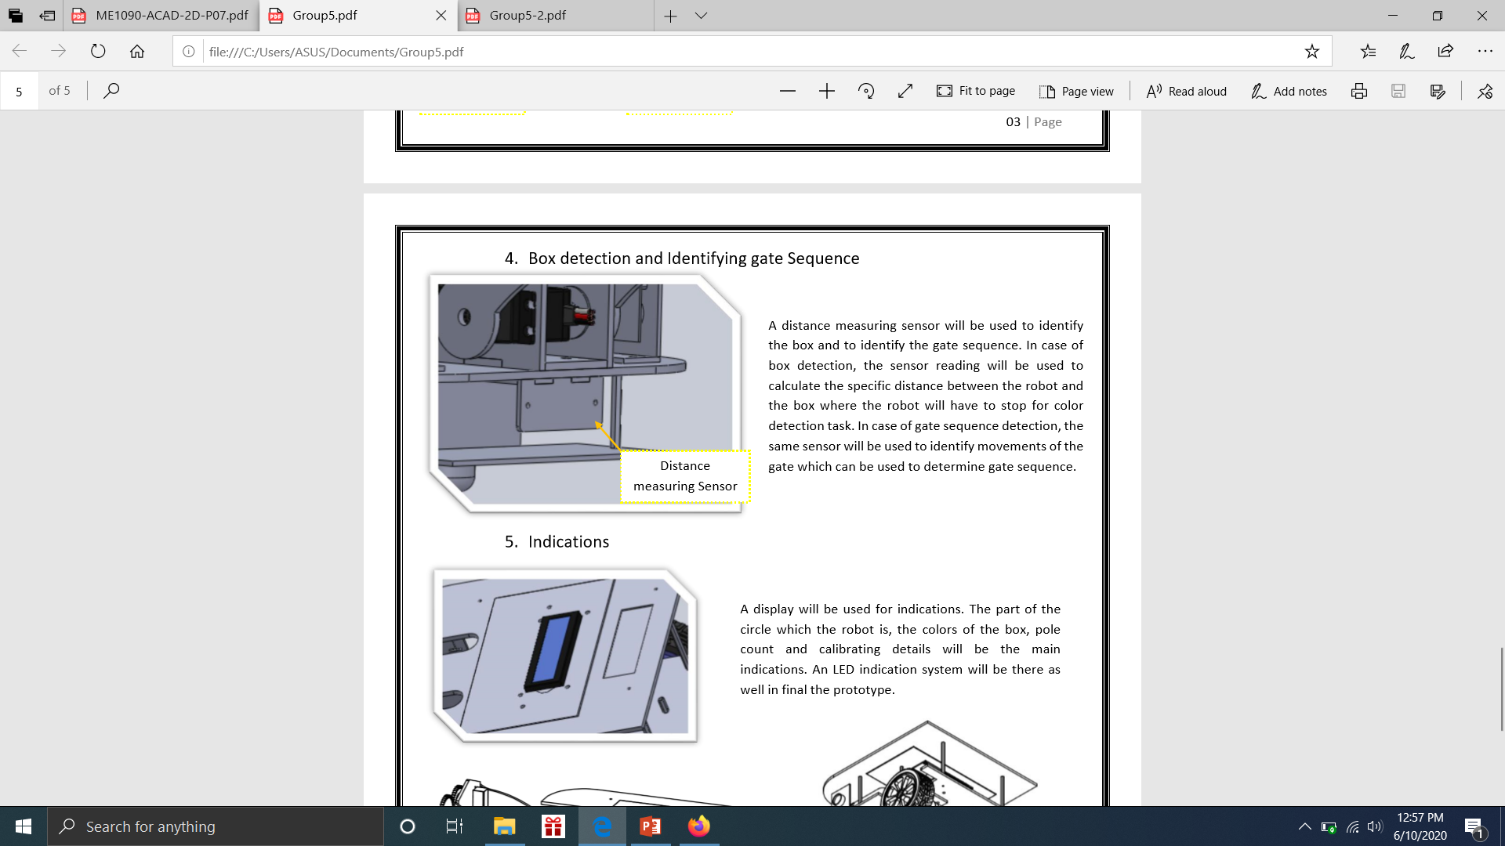
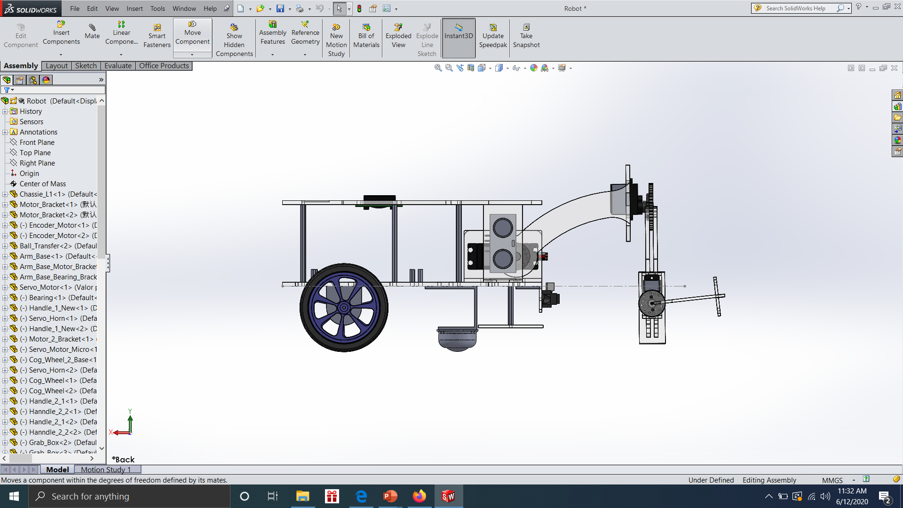
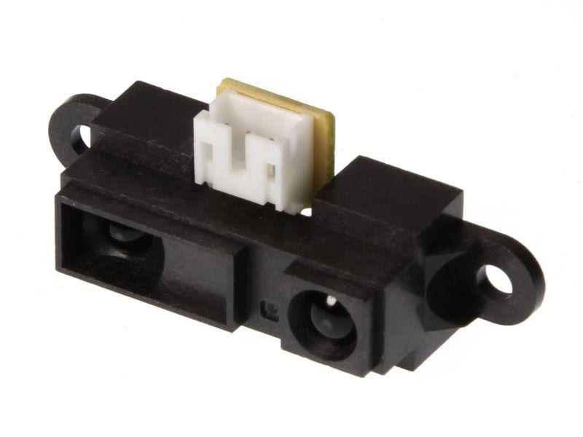
Box Detection
[] SHARP GP2Y0A21 IR sensor is used.
I Uses incident angle principle
II More accurate
III High speed response rate
[] The sensor reading will be used to calculate the specific distance between the robot and the box
where the robot will have to stop for color detection task.
[] IR sensors measures infrared light radiating from objects in its field of view.

Slide 7
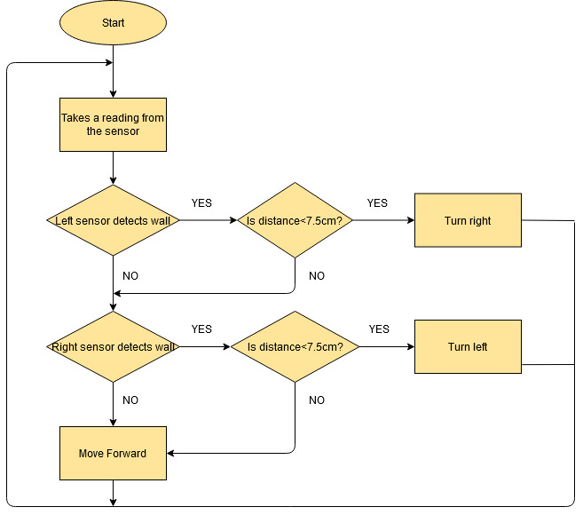
Wall Following Algorithm

Slide 8
Robot Brain
Team X- Tumbler
13.06.2020

Slide 9
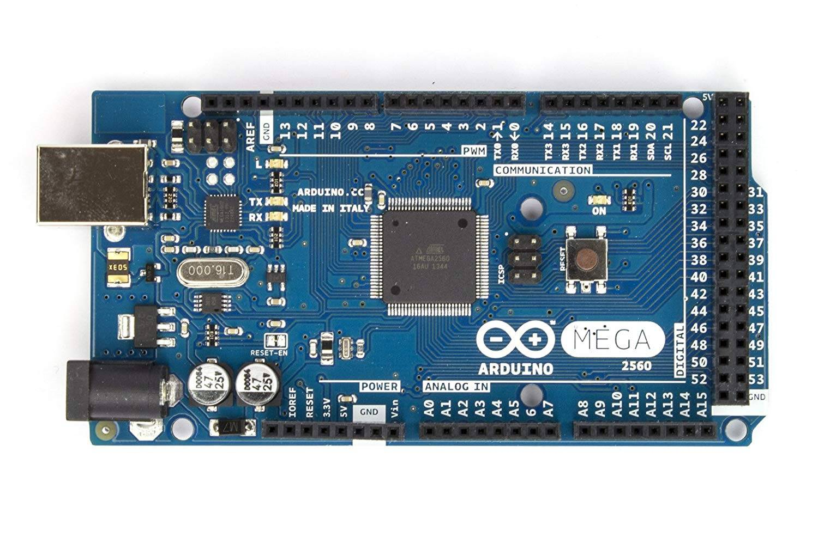
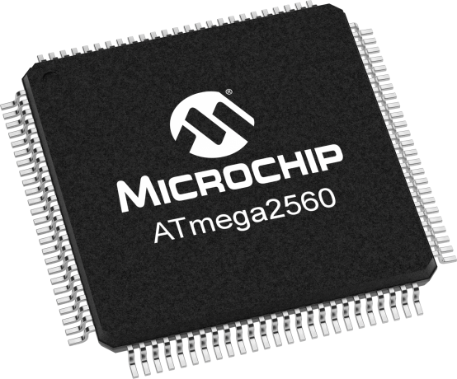
ARDUINO MEGA 2560
[] A development board based on Atmega2560 microcontroller as our robot brain.
[] Has 54 digital input & output pins.
[] Easy to use
[] Designed for the projects that require more I/O lines, sketch memory and more
RAM.

Slide 10
03
Color detection and robot arm control
1.TCS3200 color sensor
2.Robot arm design
3.Servo motor control algorithm
Team X- Tumbler
13.06.2020

Slide 11
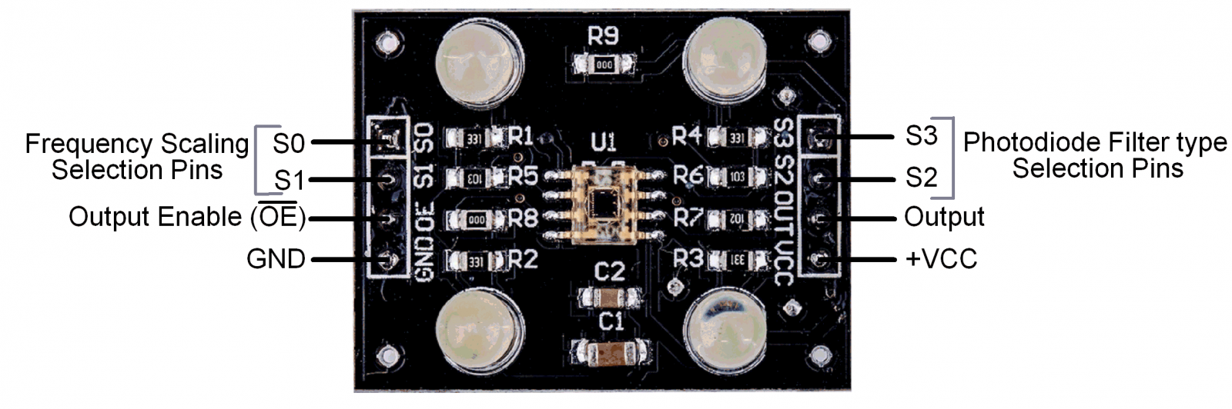
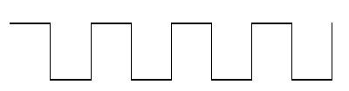
TCS3200 color sensor
[] Consists of 4 white LEDs and 8x8 photodiode array. 16 for each red, green, blue and clear filters.
[] Light reflected from surface falls on filters which produce a current proportional to the frequency of light.
[] Current-to-frequency converter generates a square wave with frequency proportional to the intensity of
received light and it is sent to the Arduino board where color can be identified by the frequency of the
signal.
[] Supply voltage: 5V and Range : ≈1”
Color filters are powered up according to the inputs given to S2 and S3 control pins
S2 | S3 | Photo diode
L | L | Red
L | H | Blue
H | L | Clear
H | H | green
Square wave
Light
8x8 array of
photodiodes
Current-to-frequency
converter
Team X- Tumbler
13.06.2020

Slide 12
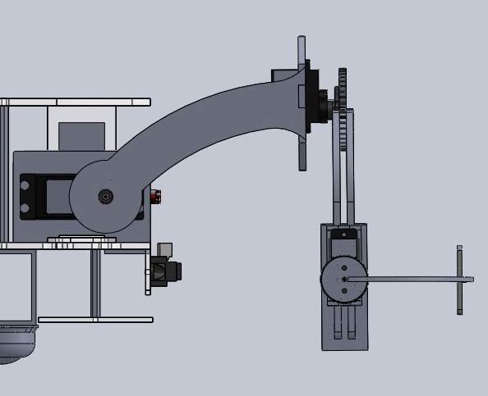
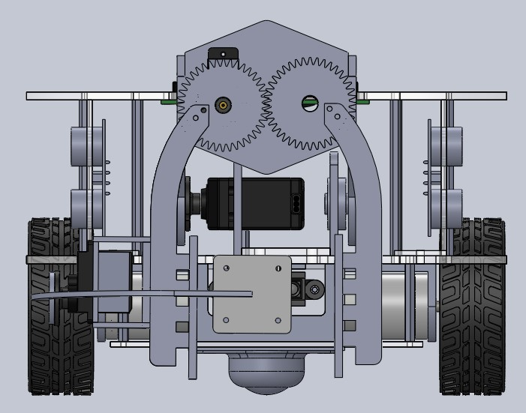
Robot arm design
3 Tower pro SG90 micro servo motors are used for M1,M2 and M3.
M2
M2
M1
M1
M3
M3
Side elevation
Front elevation
Team X- Tumbler
13.06.2020

Slide 13
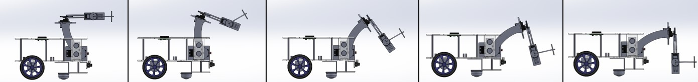
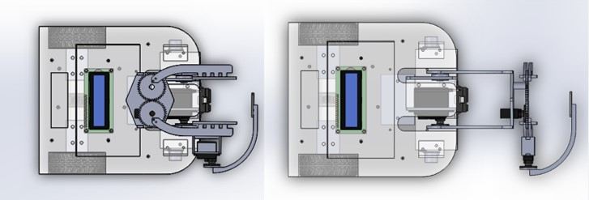
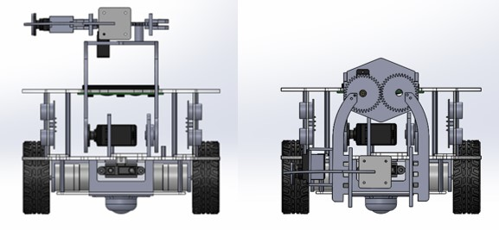
Robot arm design
Side elevation
Top elevation
Front elevation
Team X- Tumbler
13.06.2020

Slide 14
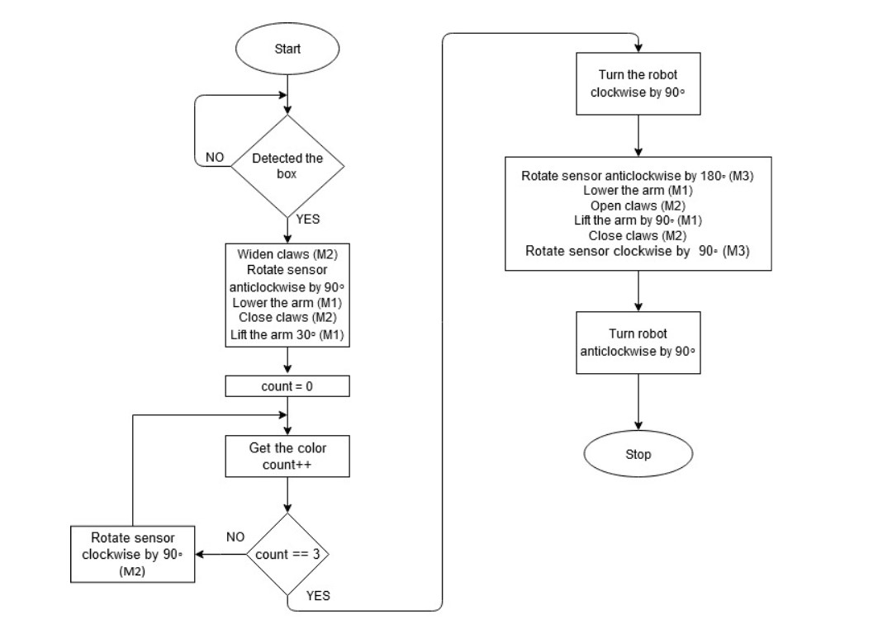
Servo motor control algorithm
Team X- Tumbler
13.06.2020

Slide 15
04
RAMP AREA
Strategy for passing ramp Successfully and robot control
Team X- Tumbler
13.06.2020

Slide 16
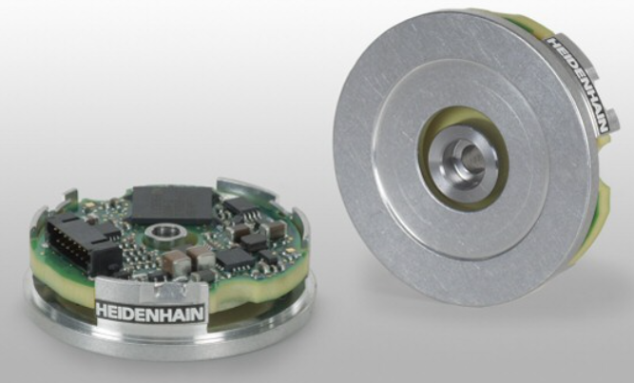
Description
[] Ramp Area has three angle segments and one top flat area segment.
[] we will not use any sensor in robot for the purpose of moving the ramp area.
[] we hope to move the robot at a constant speed throughout the ramp area.
[] The encoders are used to measure the speed of the wheels.
[] Encoders maintain a constant speed of the wheels by applying a motor control
loop through the control panel.
Team X- Tumbler
13.06.2020

Slide 17
Control loop of the encoders
Begin
Motor speed = constant
(in rpm)
Get encoder output
Calculate RPM
Wait 10ms
If
RPM== motor speed
Yes
No
Change motor speed to constant (by increasing or decreasing)
Team X- Tumbler
13.06.2020

Slide 18
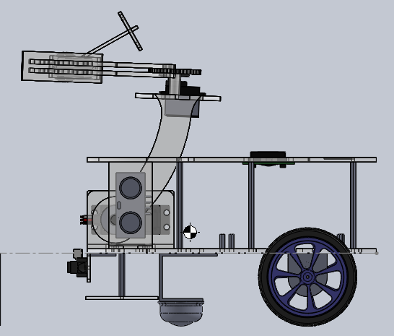
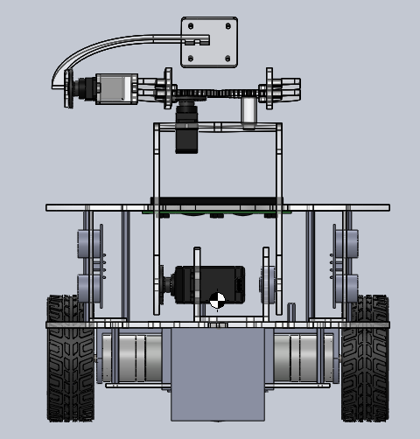
Center of gravity and stability
[] The center of gravity of the robot should be close to the base of the robot.
[] Proper positioning of the robot’s battery and other fairly heavy equipment, helps to position the center of gravity
near the base.
[] Since we have not included battery here, when we include it, the center of gravity will considerably move down
G
Team X- Tumbler
13.06.2020

Slide 19
Robot Power
Team X- Tumbler
13.06.2020

Slide 20
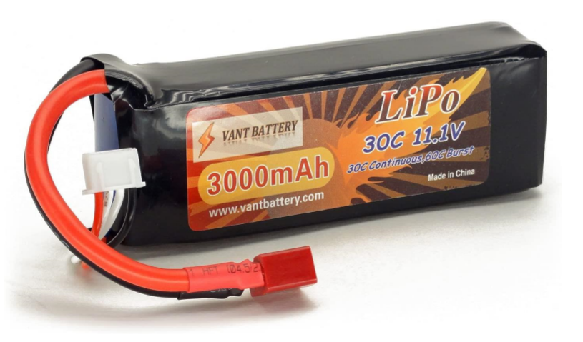
The Battery
[] We hope to use a single LiPo battery for our mobile robot.
Specifications
I Size= 132 X 43 X 23 mm
II Battery voltage = 11.1v
III Cell count and arrangement = 3s
IV Battery capacity = 3000mAh
V Discharge rate = 30C continuous and 60 burst
Team X- Tumbler
13.06.2020

Slide 21
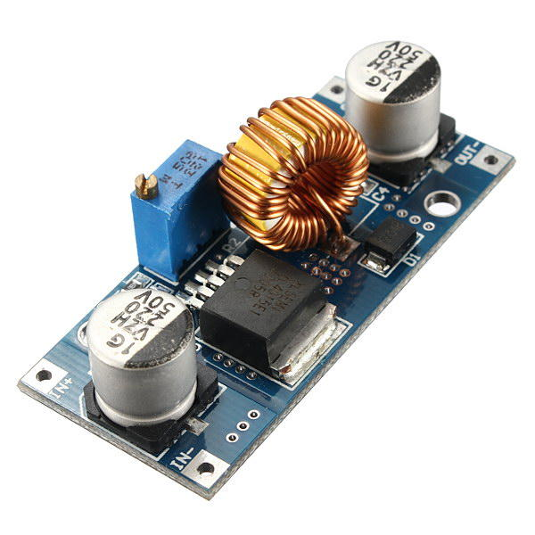
Reasons for selecting the battery
[] LiPo batteries are light weight.
[] High discharge rate
[] Higher capacity
Voltage step up and step down
[] Since we will use a single battery, a 5V buck converter will be used to step down this
11.1v to 5v for microcontroller and sensors.
[] A 6v buck converter will be used for servo motor.
[] A 12v boost converter will be used for DC motors.
Team X- Tumbler
13.06.2020

Slide 22
05
Gates
Identifying the sequence of gates
Methodology for passing them successfully
Team X- Tumbler
13.06.2020

Slide 23
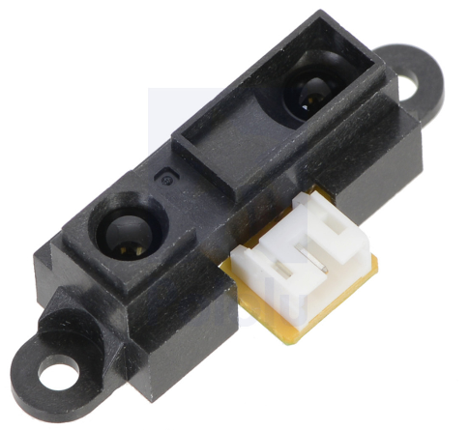
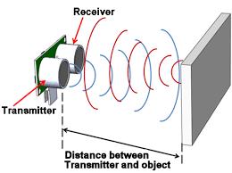
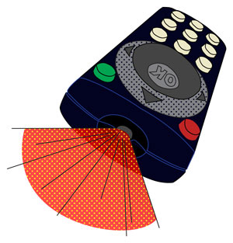
Sensors & Specifications Phase
[] GP2Y0A21 Sharp IR Sensor
Why we selected this sensor ?
| . Wave Propagation mode
II . Resolution
III. Range
IV. Accuracy
V. Simplicity
Team X- Tumbler
13.06.2020

Slide 24
Begin
If
R > Threshold 2
No
Readings count = 0
Time = 0
Previous state = “C”
Current state = “C”
Prev. state = Current state
Current state = “O”
Yes
Get Reading
Prev. state = Current state
Current state = “C”
If
Reading > Threshold 1
No
If
Prev. state = “C” and
Current state = “O”
No
Yes
Readings count ++
Yes
If
Time > 1s
No
Delay = 1s
Time += 10ms
End (GO!)
Algorithm
Yes
Team X- Tumbler
13.06.2020
Readings density (R) = readings count / 1s

Slide 25
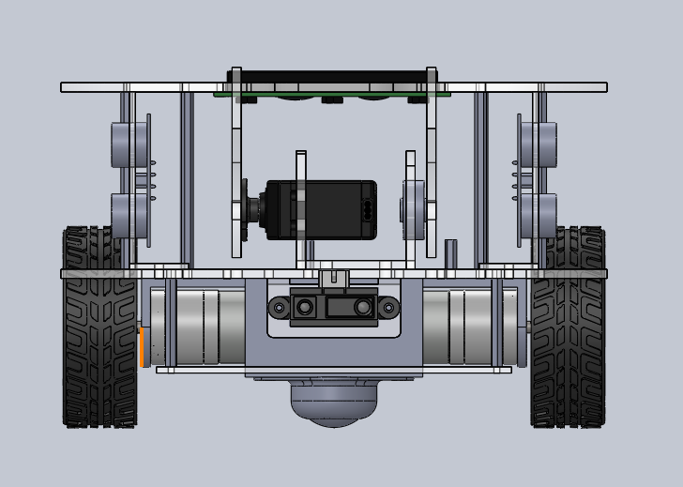
Hardware Design Phase
3 cm
Team X- Tumbler
13.06.2020

Slide 26
Thank You!
Task | Person
Line Following | T. A. D. S. Tennakoon 180639P
Wall Following | H. A. D. G. Hettiarachchi 180236D
Color Detection | D. N. R. Dissanayake 180153U
Ramp Area | N. G. K. M. Dayasekara 180112U
Gates | M. M. C. J. Bandara 180065C
Team X- Tumbler
13.06.2020

